Slide 1
Fresh Grads – Group Project
Movie Ticket Booking System

Slide 2
Problem Statement
To Create an Application for Movie Ticket Booking System
Customer should be able to view movies and theatres.
Customer can able to see the amount for the movie booked.

Slide 3

Road Map
Application will be developed in following Sprints –
Core Java +JPA with Hibernate
Spring Boot + Rest Controller + JPA with Hibernate

Slide 4
Plan
Design
Generate the skeleton as per class design provided
2. TDD approach
Identify test cases for each module
Write Failing Test cases
Convert the Test Cases in GREEN

Slide 5
Modules
Administrator Module
Customer Module
Show in Charge
Module

Slide 6
Administrator Module
The admin can add admins to the database and only the registered admins can make the changes required to the website.
Admin can add the movies to the database.
Admin can add the theatres where the released/particular movie screens in any city.
Admin can update the movie date, time or place of screening.
Admin can also delete the movies once they are no longer shown in the theatres.

Slide 7
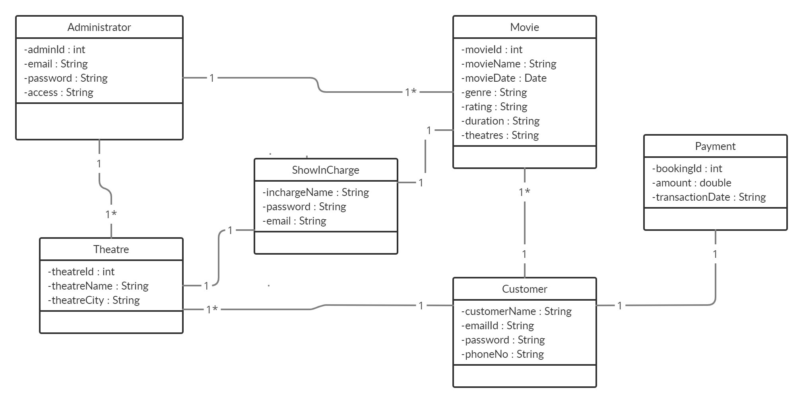
Class Design
POJO Classes:

Slide 8
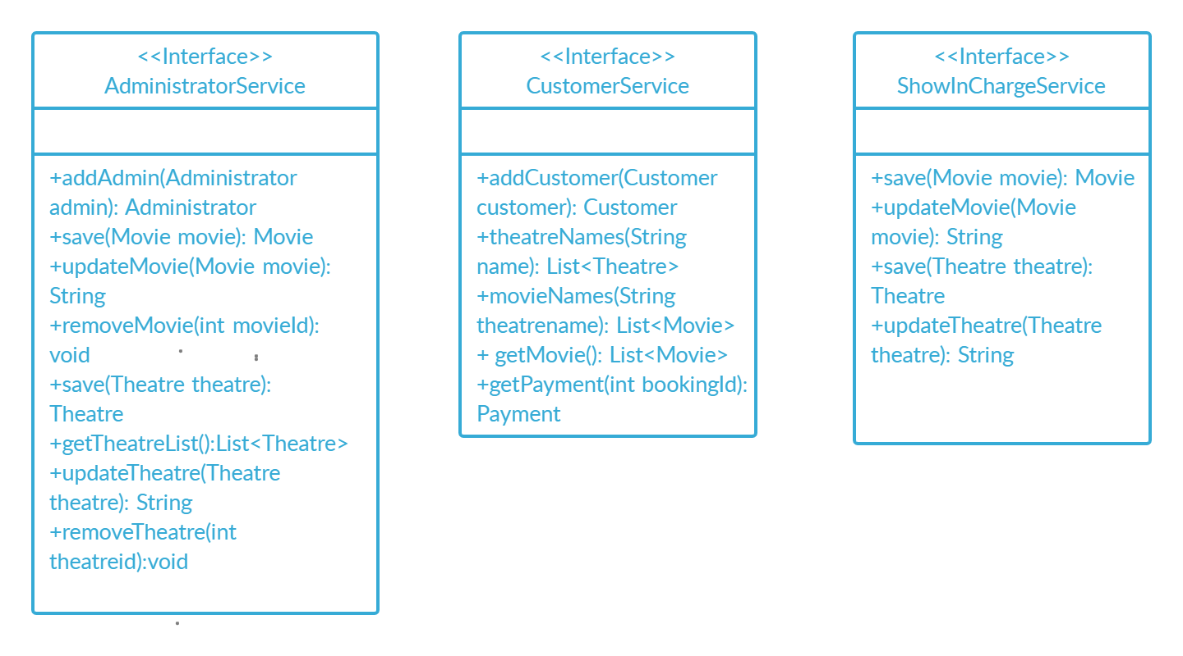
Class Design
Service Interface:

Slide 9
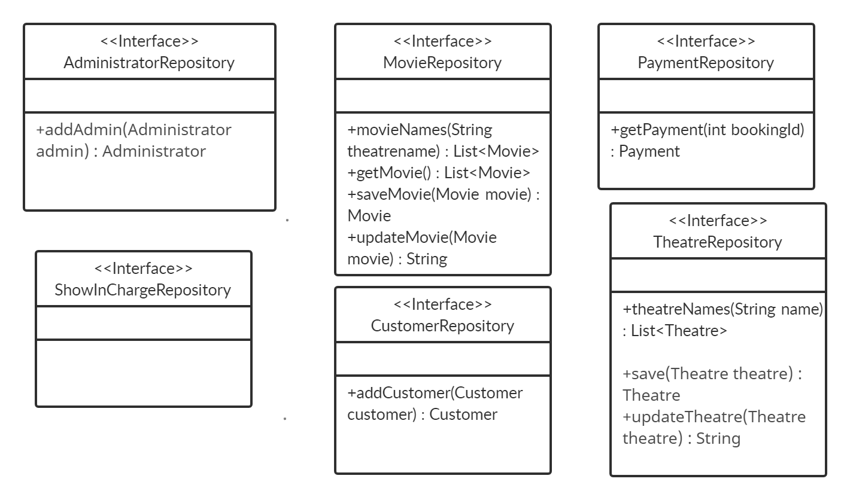
Class Design
Repository:

Slide 10




Questions

